Slide 1
Week 3 Internship
Samarth Sharma

Slide 2
Recorded the videos for the tutorial
Implemented MUSIC on Vitis 2024.2 and checked it on the board
Analysed the results for MUSIC

Slide 3
Tutorial
Created 4 videos:
Explained the workflow, implemented 8x8 unoptimized Matrix Multiplication on Vitis Unified IDE 2024.2, analysed synthesis report, exported the IP
Imported IP to Vivado, explained block diagram and generated the bitstream
Created the pynq driver for the 8x8 unoptimized bitstream
Covered latency and resource optimizations, presented all final results in the form of a ppt comparing acceleration factors and RMS errors

Slide 4
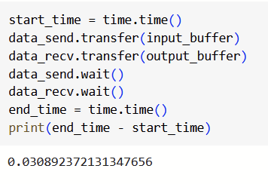
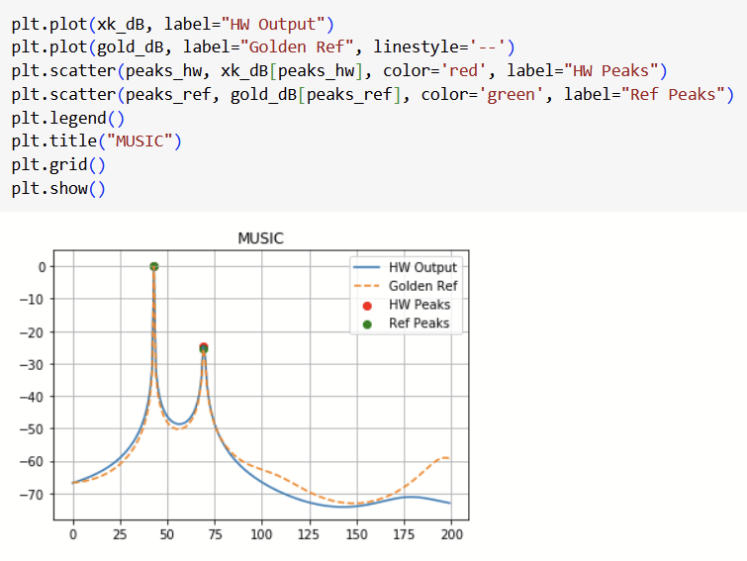
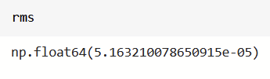
MUSIC on 2024.2

Slide 5
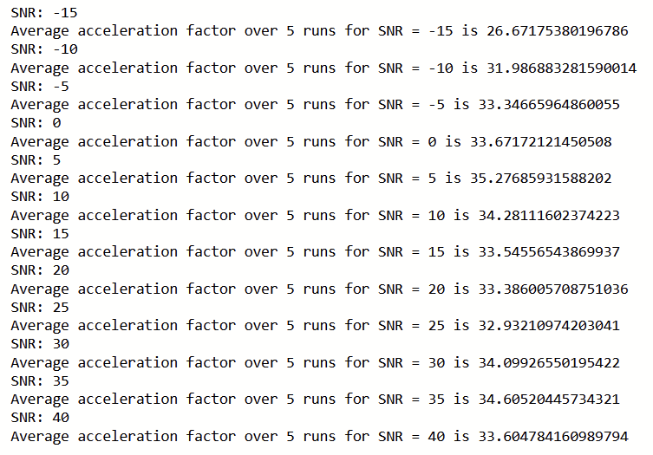

Slide 6
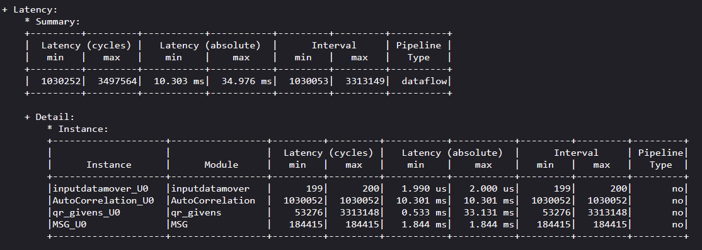
Latency in 2024.2

Slide 7
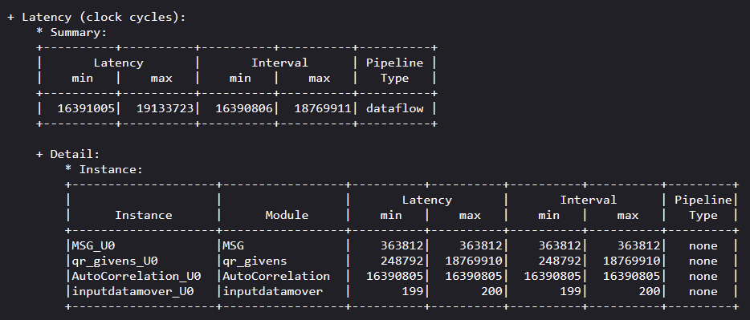
Latency in 2019.1

Slide 8
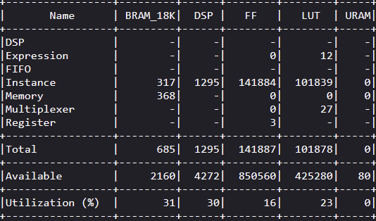
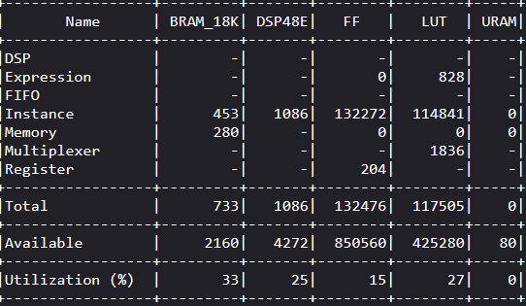
Resources(Vitis)
2024 2019

Slide 9
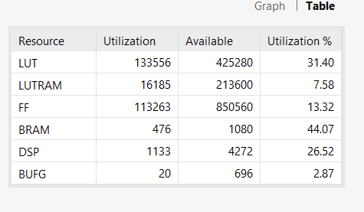
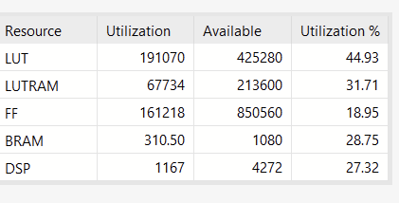
Resources(Vivado)
2024 2019

Slide 10
Thank you!

